Slide 1
Introduction to DevOps

Slide 2
OVERVIEW OF DEVOPS
Technology is really transforming every aspect of industry, and digitalization and automation have flourished in the past few years.
According to a recent market survey, the DevOps market will exceed $20 billion by 2026, growing at a CAGR of 24.7% from 2019 to 2026. DevOps has facilitated rapid and dependable software development, delivery, improved quality and higher customer satisfaction.
Source: https://www.verifiedmarketresearch.com/product/devops-market/

Slide 3
Course Outline
What is DevOps?
Why DevOps?
How DevOps Works
Benefits of DevOps
DevOps Tools
Roles and Responsibilities of a DevOps Engineer
DevOps Use Case in Netflix

Slide 4

About Me
My name is Oyekanmi Olalekan
Software and DevOps Engineer @ Codar

Slide 5
1. What is DevOps?
Let’s start

Slide 6
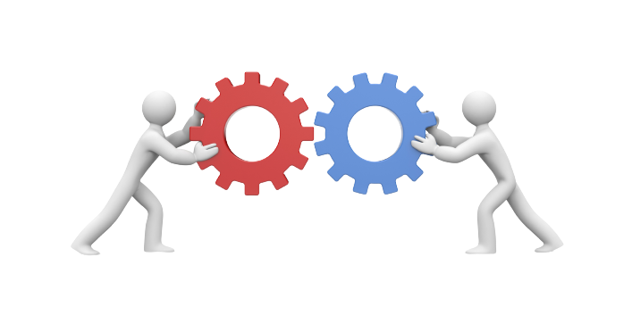
What exactly is DevOps?
DevOps is a practice or methodology of making ‘Developers’ and ‘Operations’ team work together.

Slide 7
2. Why DevOps?

Slide 8
Why DevOps?
Before understanding the concepts and methodology of DevOps, we need to understand why do we even need DevOps and not other methods.
Before DevOps, there were two development models: Waterfall and Agile Method.

Slide 9
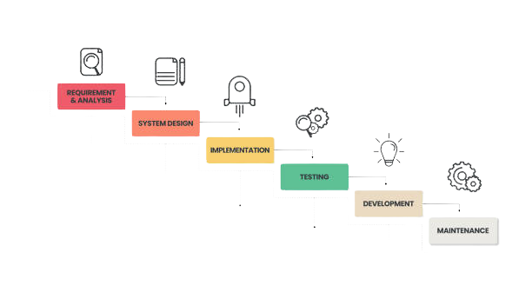
Waterfall Model
In this approach, software development is divided into several phases, and the output of one phase becomes the input for the next phase.
This model is follows a sequential flow and was considered to be reliable at first.

Slide 10
Drawbacks of the waterfall model:
It’s difficult to make changes to the previous stage
Not recommended for large-sized projects
Developers and testers don’t work together (which can result in a lot of bugs at the end)
Not recommended for projects that will likely have changing requirements

Slide 11
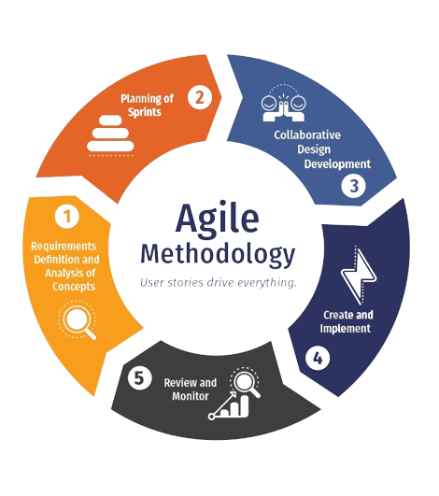
Agile Model
Agile is an approach in software development where each project splits into multiple iterations (Sprints).
As a result, at the end of each iteration, a software product is delivered. Each iteration lasts about one to three weeks. Every iteration involves functional teams working simultaneously on various areas.

Slide 12
Drawbacks of the Agile model:
Agile addresses gaps in Customer and Developer communications
Poor resource planning
Because of the ever-evolving features, there is always a risk of the ever-lasting project.
Environment barrier.

Slide 13
3. How DevOps Works?

Slide 14
DevOps
DevOps is a collaboration between development and operation teams, which enables continuous delivery of applications and services to our end users.
DevOps focuses on bringing all the development, operations and IT infrastructure guys, including Developers, Testers, System Admins, and QAs, under one roof. Hence, all these people together are called DevOps Engineers.

Slide 15
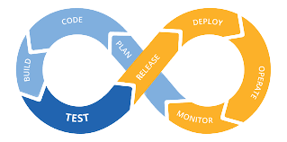
DevOps Lifecycle

Slide 16
code
Build
Test
Release
This is the first step in the DevOps lifecycle. At this stage developers build the code on any platform
At this stage developer build their program in any extension depending opon the language they are using.
For a successful software development, testing process need to be automated
After testing, the program needed to be manage, plan, schedule and control.
Deploy
Operate
Monitor
Plan
At the stage all code/artifacts files of the app are get ready for deployment and execution.
The app is now live and running on a server - where clients/users can access.
The stage identify issues of specific releases and understand the impact on end-users.
The stage gather feedbacks/logs from the monitoring stage uptime and optimal performance and implements the change for better performance.

Slide 17
4. Benefits of DevOps

Slide 18
Benefits of DevOps
Continuous delivery of software
Better collaboration between teams
Easy deployment
Better efficiency and scalability
Errors are fixed at the initial stage
More security
Less manual intervention (which means fewer chances of error)Continuous delivery of software

Slide 19
5. DevOps Tools

Slide 20
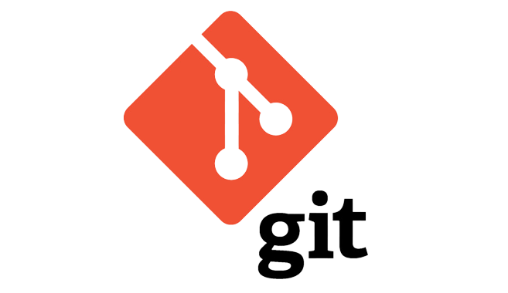
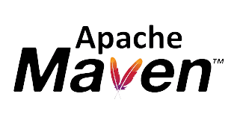

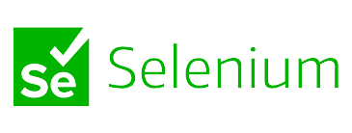
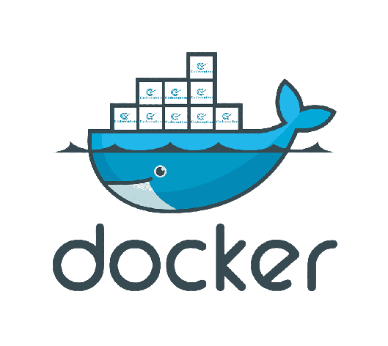

DevOps Tools
Continuous delivery of software

Slide 21
6. Roles Of DevOps

Slide 22
Roles and Responsibilities of DevOps
Project Planning
Design, Development and Deployment
Communication and support
Technical skills
Interpersonal skills
Troubleshooting

Slide 23

7. Case Study: Netflix

Slide 24
Case Study: Netflix
Netflix is the world’s leading media subscription provider that streams various TV shows and movies on our favourite smart devices, delivering the best experience anywhere at anytime to more that 75 million global customers.
Netflix uses Nebula for building its applications, then the code is tested locally using Nebula. The changes are committed to their central Git repo.

Slide 25
Case Study: Netflix
Then all applications are migrated to the cloud-based microservices in AWS. The microservice architecture allows teams at Netflix to be loosely coupled, building and pushing changes at a speed they are comfortable with.
After which a Jenkins job is created to help execute Nebula, which further builds, tests, and packages the application for further deployment.
The bulid is further baked into an Amazon Machine Image (AMI). Once the baking is complete, Spinnaker then help with the deployment by making the final AMIs available for millions of users

Slide 26
4. Job Opportunities in DEVOPS

Slide 27
Job Opportunities in DevOps
Devops Evangelist
Code Release Manager
Automation Architect
Experience Assurance
Software developer/tester
Security Engineer

Slide 28
5. CONCLUSION

Slide 29
Conclusion
Now we have acquired a detailed understanding of DevOps, its life cycle, various DevOps tools, its use cases and most importantly the roles and responsibilities of DevOps Engineers.

Slide 30

Q/A
Session

Slide 31
THANKS!

